Slide 1


Slide 2






A language of Styling!
What is CSS
CSS (Cascading Style Sheets) is a stylesheet language used to design a webpage to make it attractive. The reason for using this is to simplify the process of making web pages presentable.

Slide 3

How CSS is different from HTML?
HTML is used to define a structure of a web page whereas CSS is used to style the web page by using different styling features.
HTML consist of tags inside which text is enclosed and CSS consists of selectors and declaration blocks.
97.0%
CSS is used by 97.0% of all the websites.
DID YOU KNOW?

Slide 4


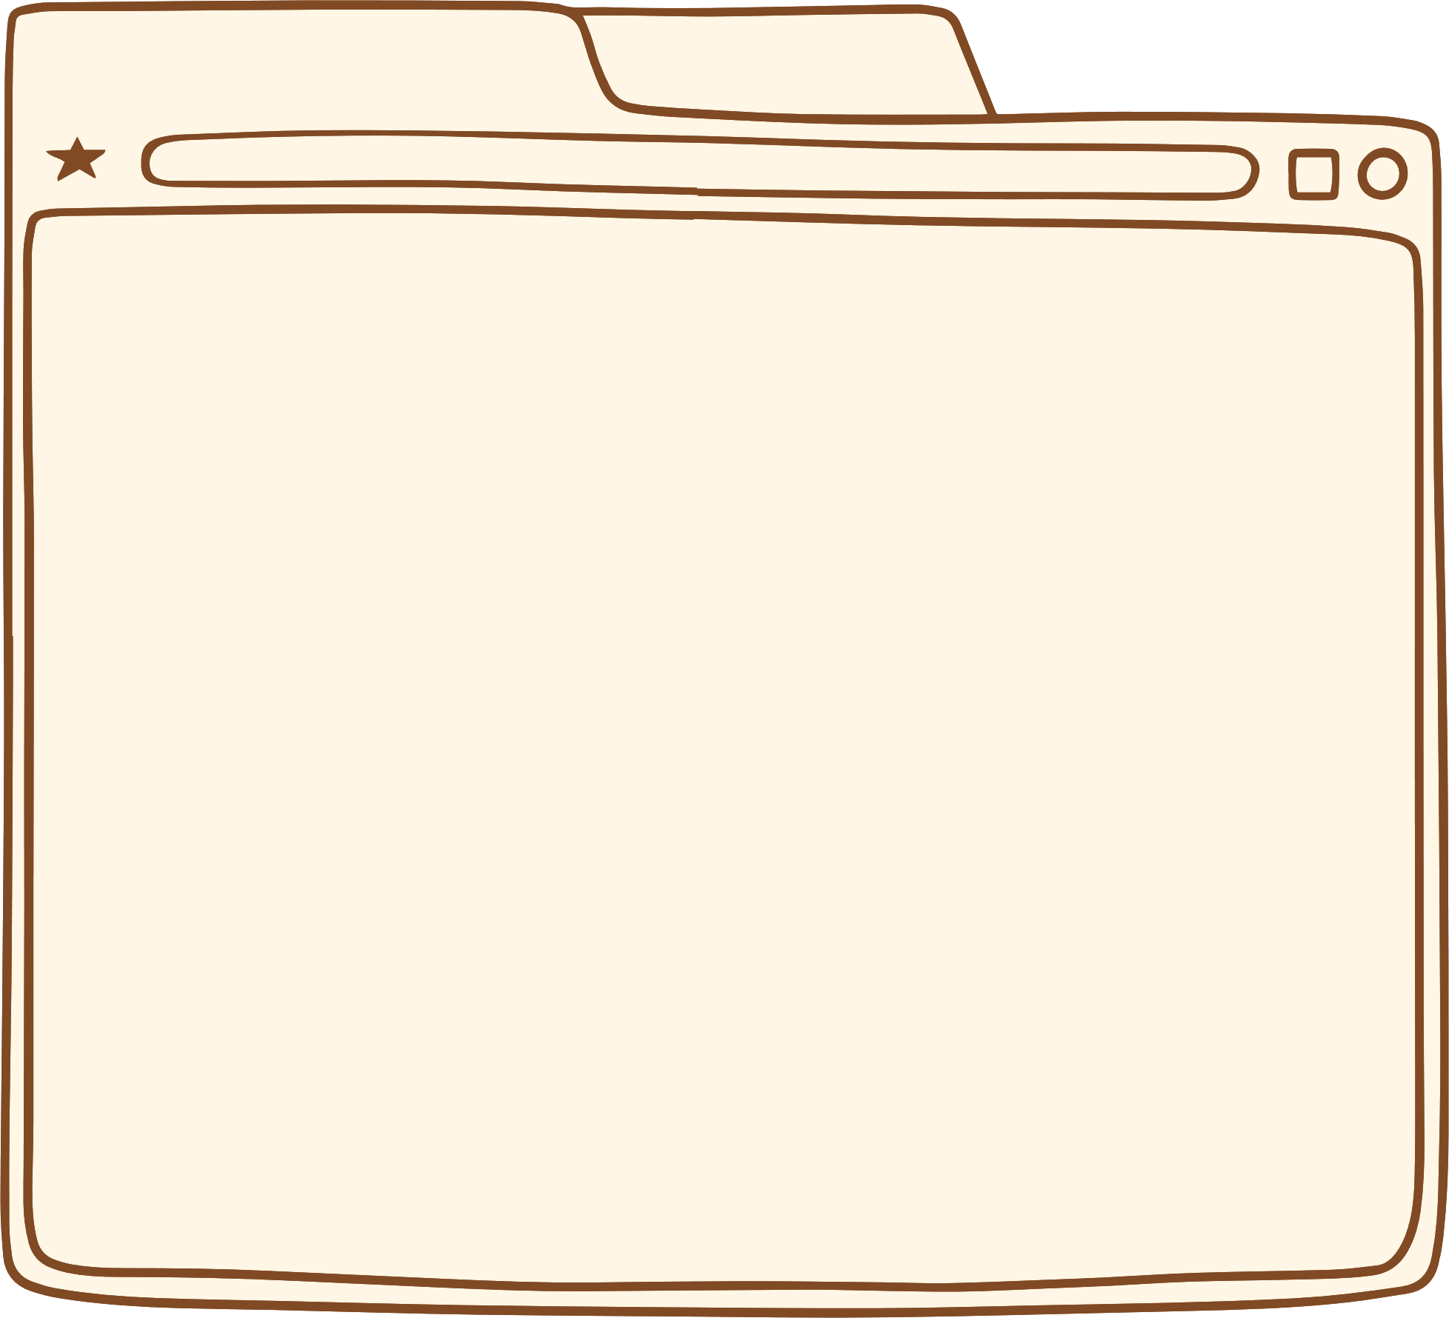


So, why CSS ?
CSS helps you to keep the informational content of a document separate from the details of how to display it. You keep the style separate from the content so that you can:
Avoid duplication
Make maintenance easier
Use the same content with different styles for different purposes

Slide 5
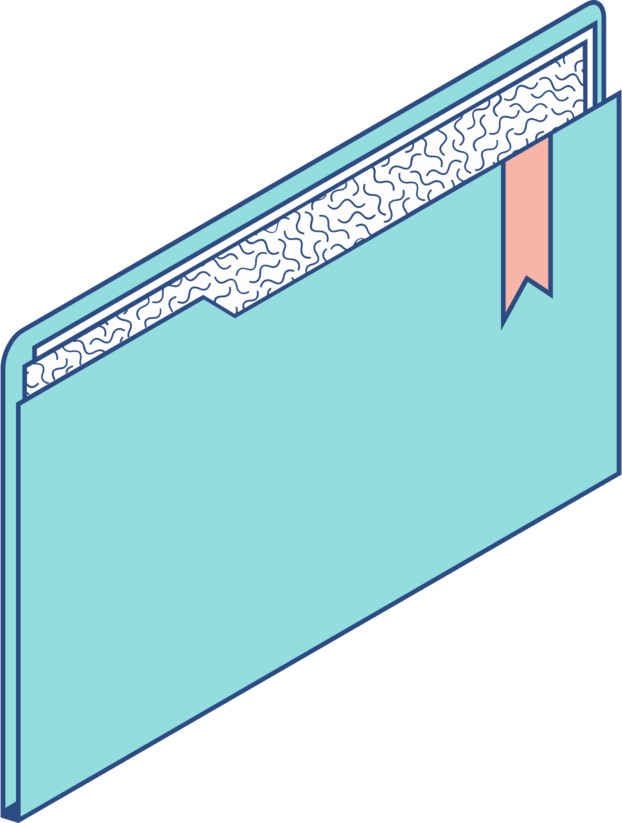
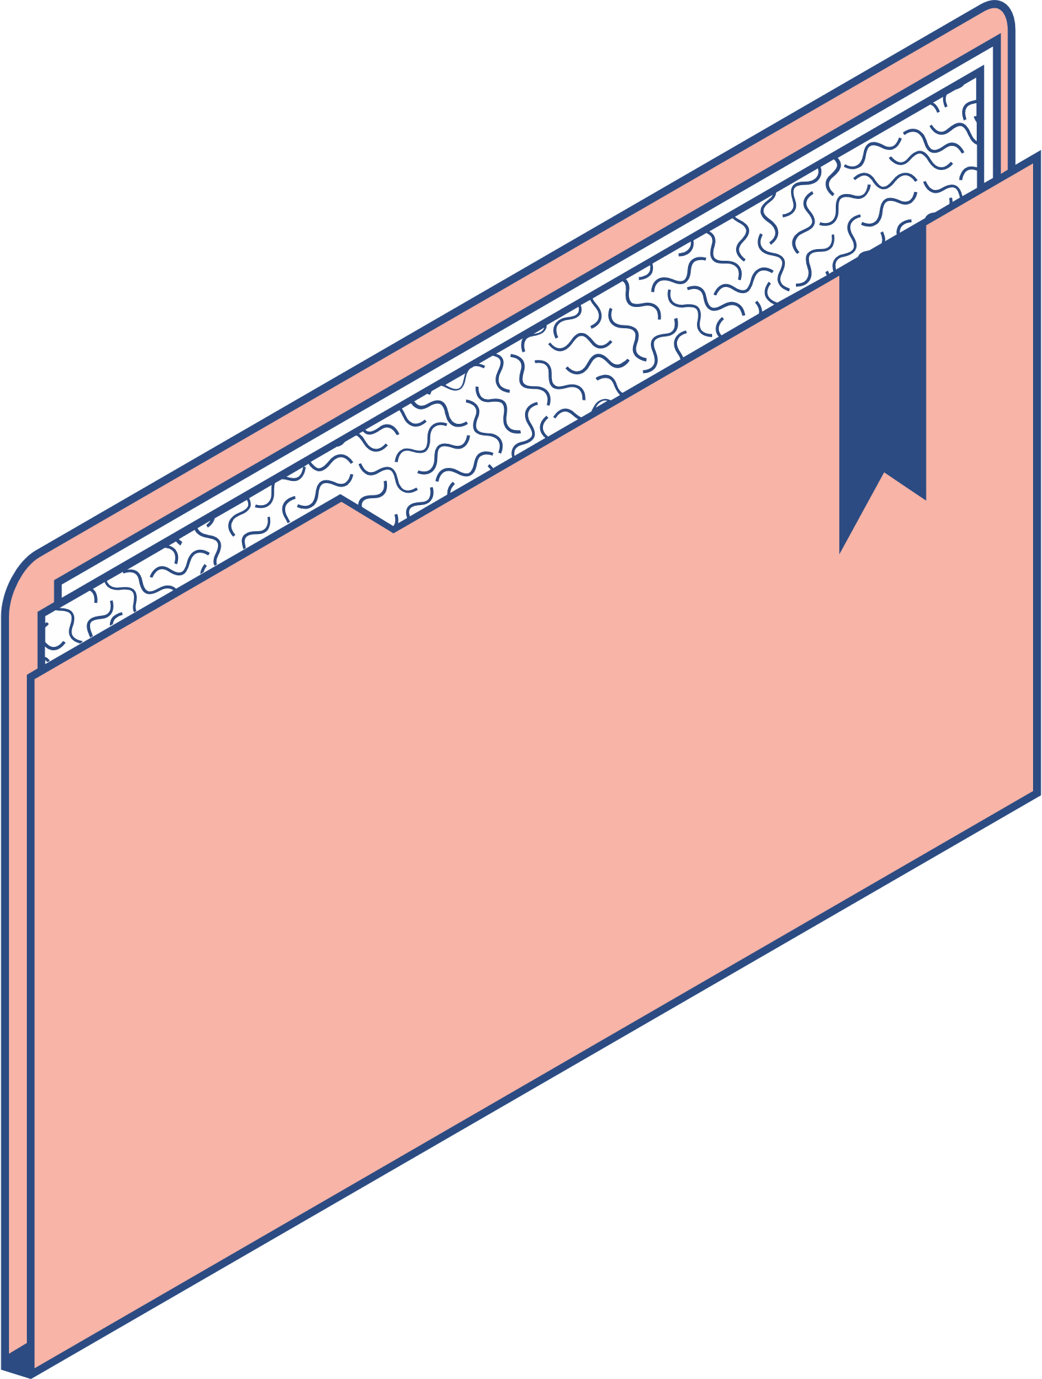
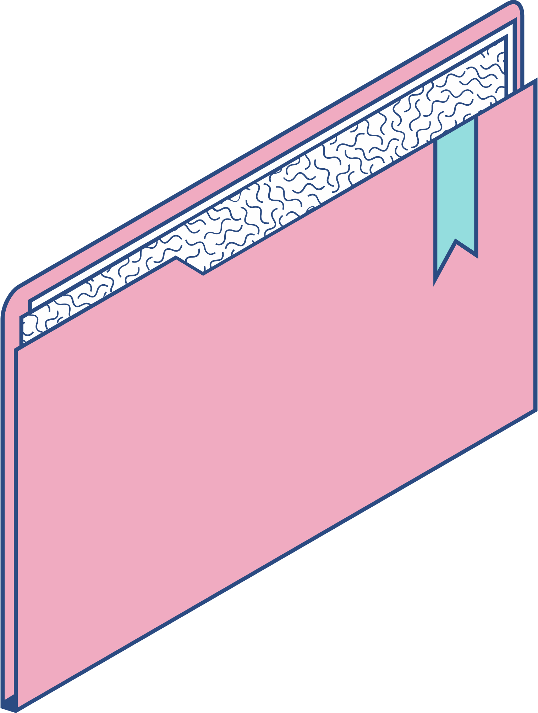
CSS Syntax
Selector {
property1 : value;
property2 : value;
}

Slide 6
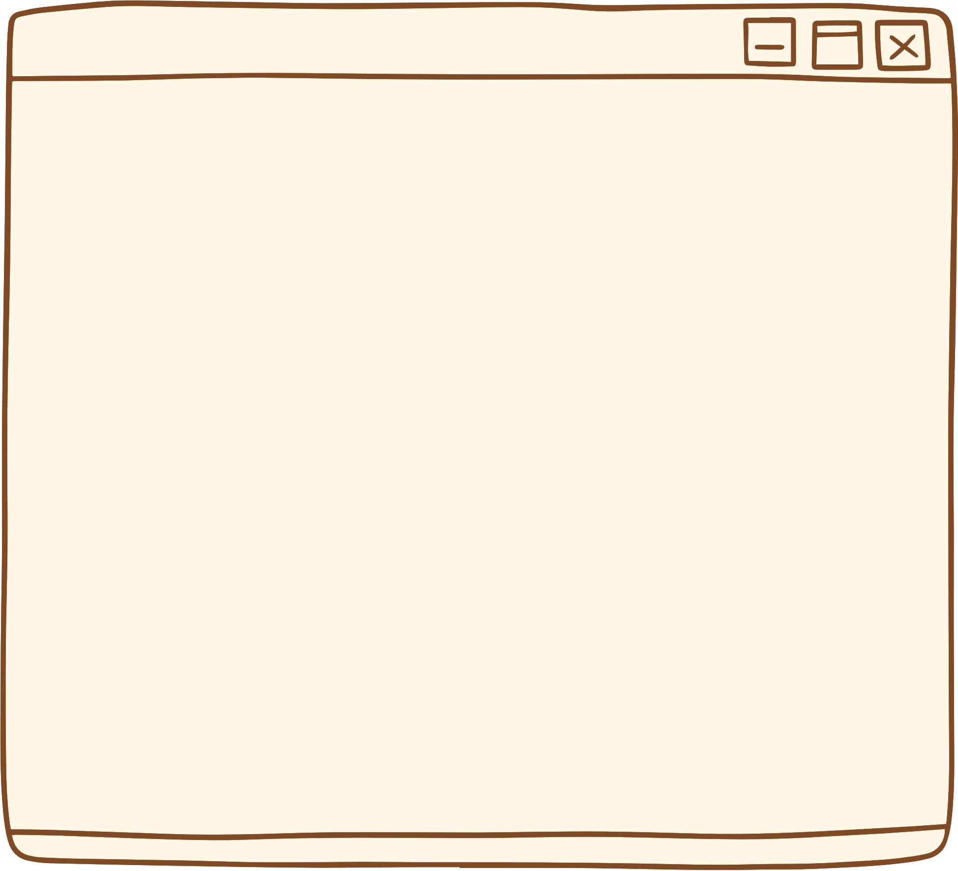

How to add CSS ?
Internal CSS
Inline CSS
External CSS
The internal style is defined inside the <style> element, inside the head section.
Adding CSS inside <head> tag of the HTML code.
Inline styles are defined within the "style" attribute of the relevant element

Slide 7

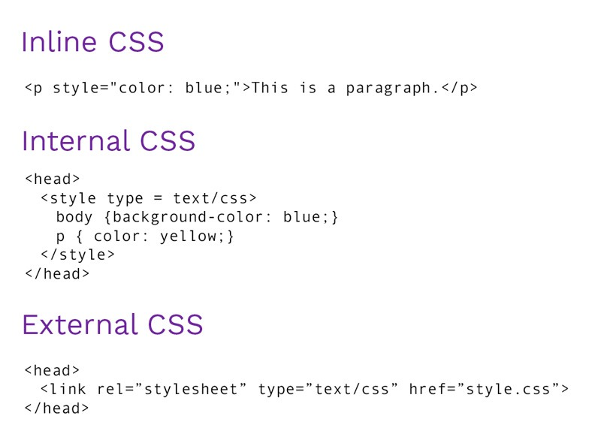
Syntax please?

Slide 8
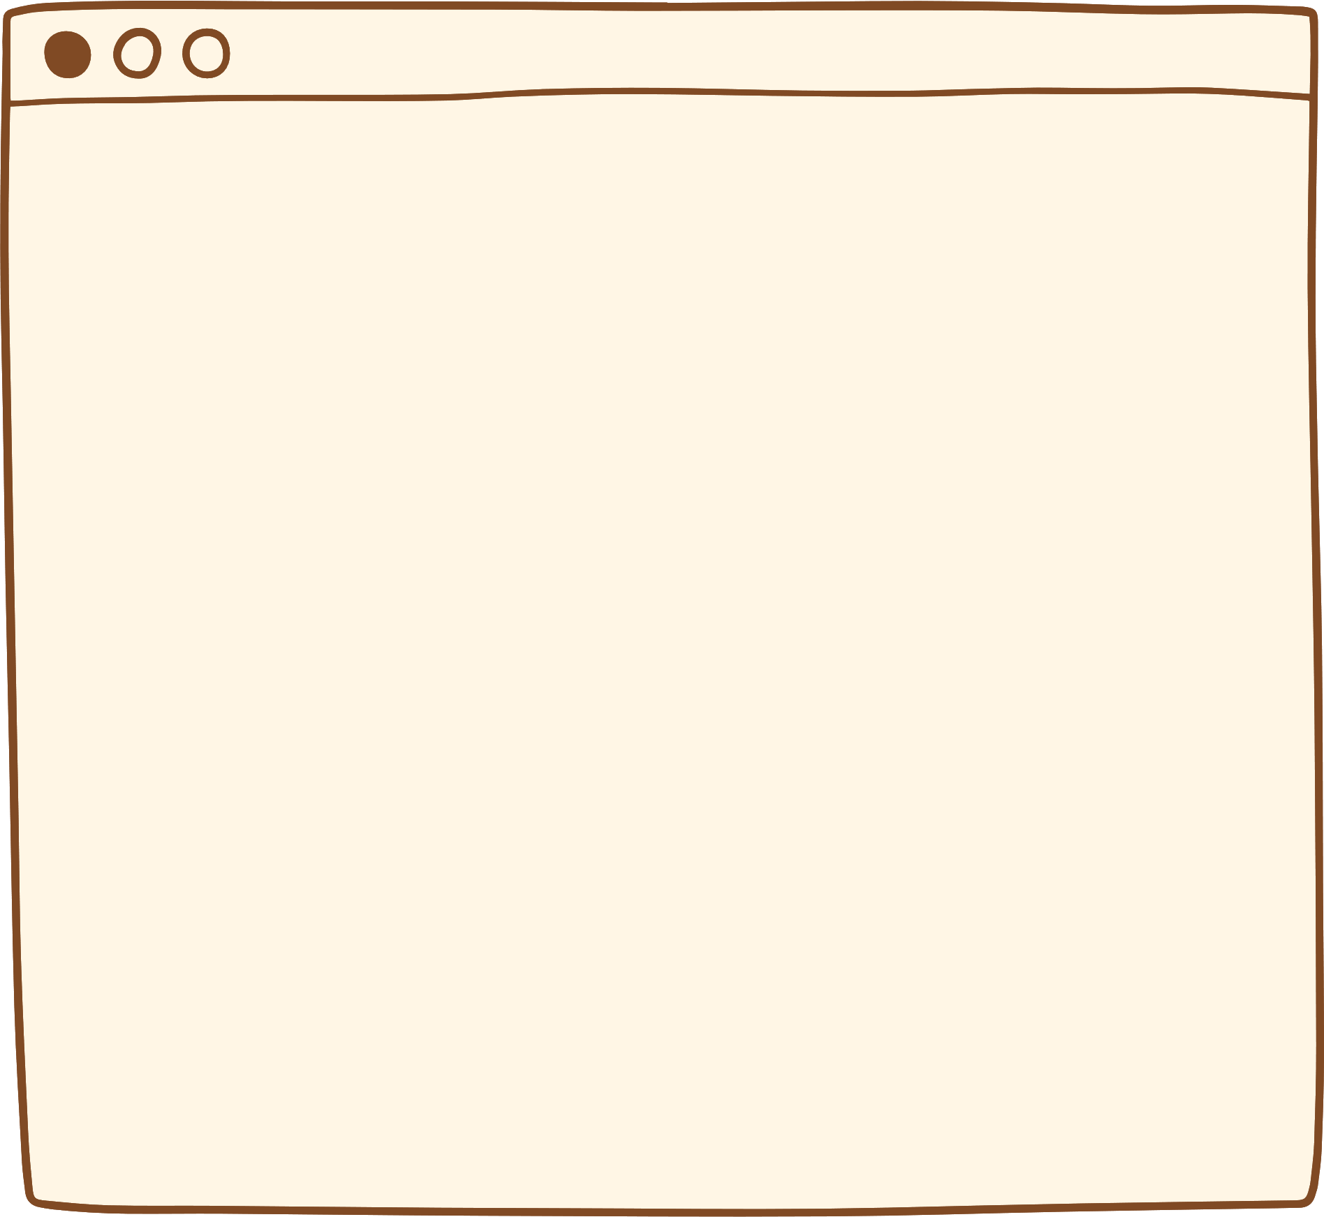
CSS SELECTORS
Element
Class
ID
element_name{
CSS properties;
}
.class_name{
CSS properties;
}
#id_name{
CSS properties;
}

Slide 9
CSS SELECTORS
Combinators
Pseudo-classes
Attribute
div > p {
color : green;
font-size : 32px;
}
.selector : pseudo-class{
property : value;
}
a[title]{
color : purple;
}

Slide 10


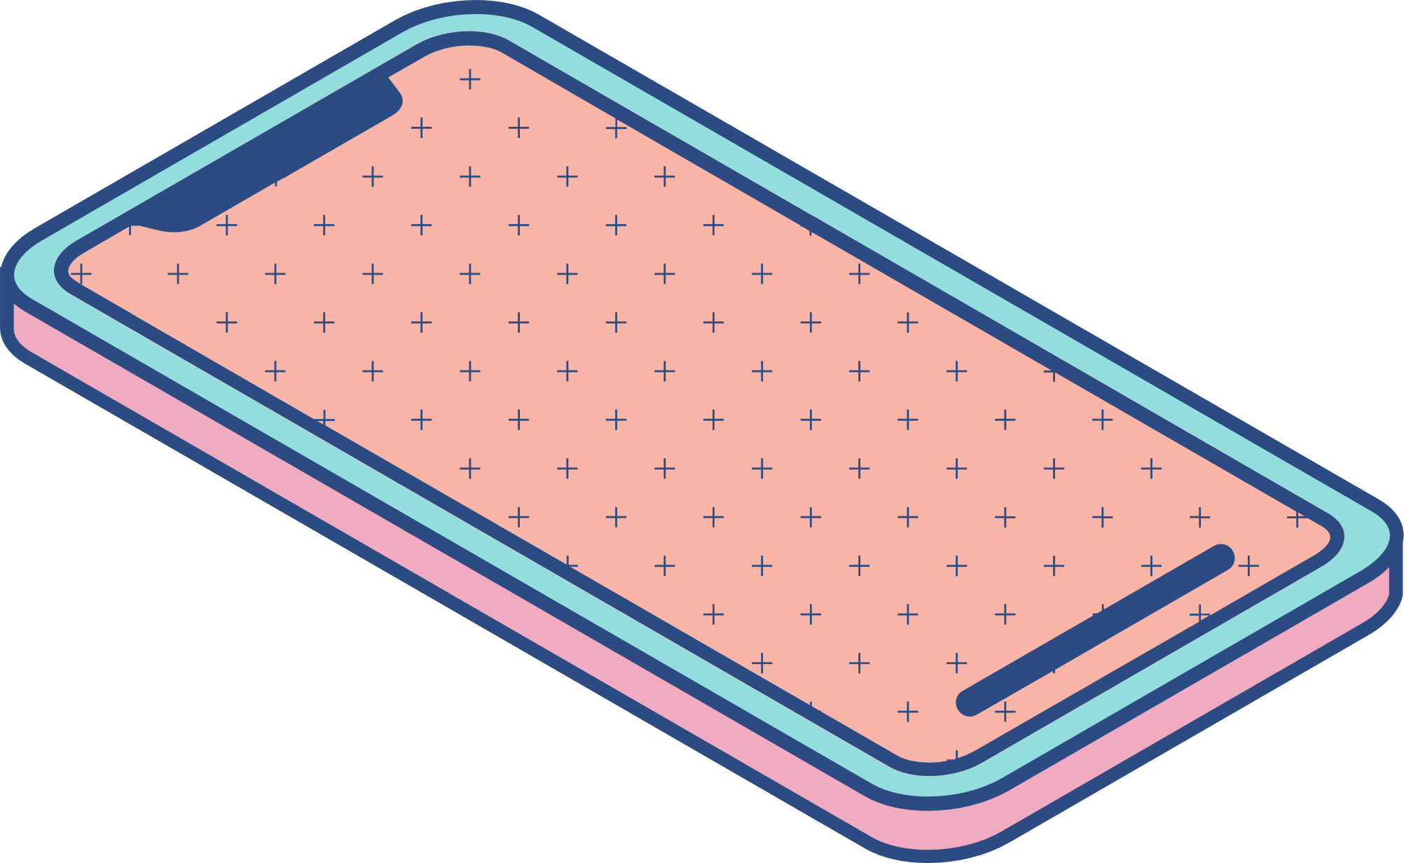
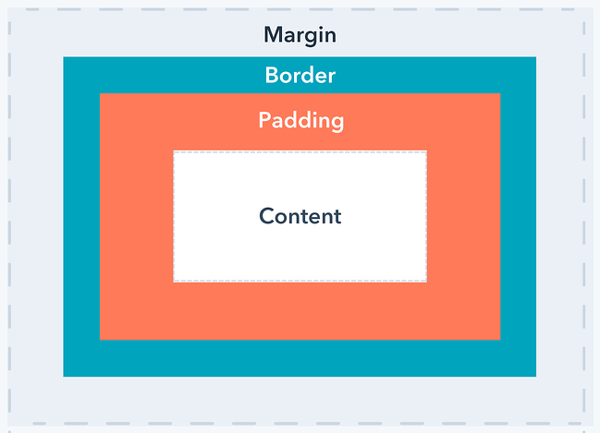
Frequently used properties

Slide 11
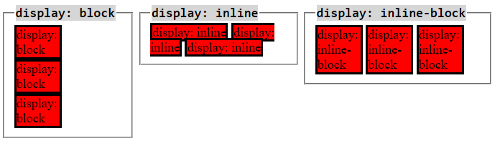
Frequently used properties

Slide 12
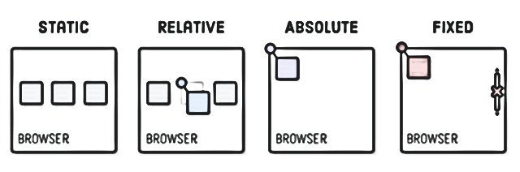
Frequently used properties

Slide 13
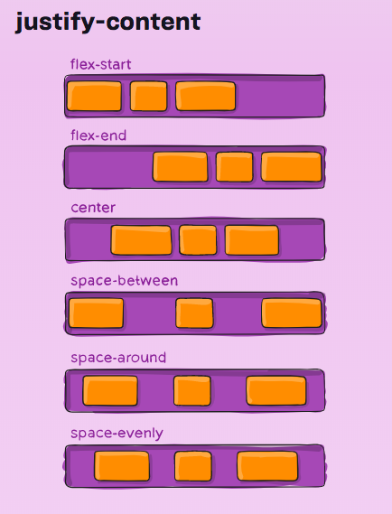
Frequently used properties

Slide 14
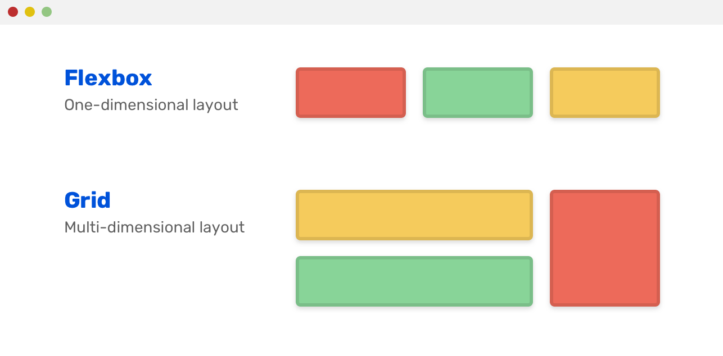
Frequently used properties

Slide 15
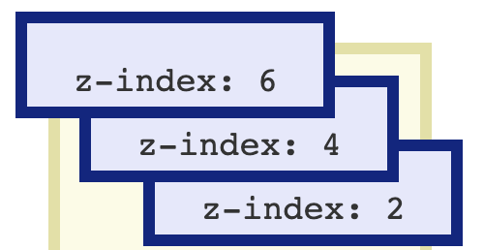
Frequently used properties

Slide 16

Frequently used properties – hover effect

Slide 17
CSS Property
Display
Font-family
Font-weight
Letter-spacing
Line-height
List-style
margin
Overflow
Padding
Position
Text-align
Text-decoration
Visibility
Z-index
background
background-color
border
border-color
border-left
border-radius
Clip
Color
Filter
Font-variant
Height
List-style-type
Position
Stroke-dasharray
Top
Vertical-align
Width
Animation
Flex box
Transition
Direction
Flex wrap
White spacing
Flex-flow

Slide 18

CSS is magic and you can be a magician!
Divyanshu

Slide 19

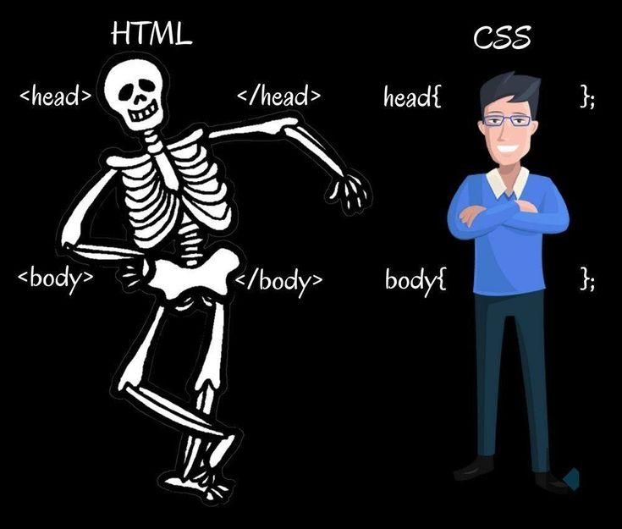
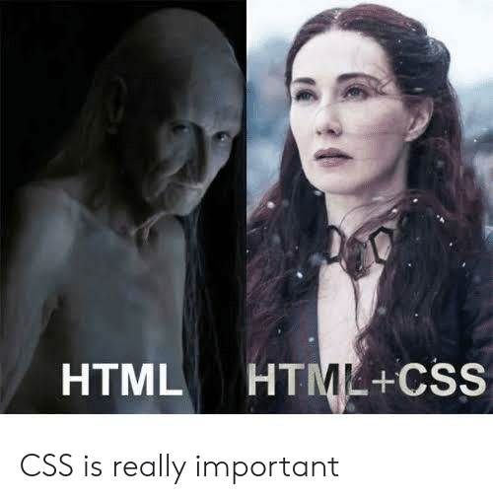
Let’s Code!

